Slide 1
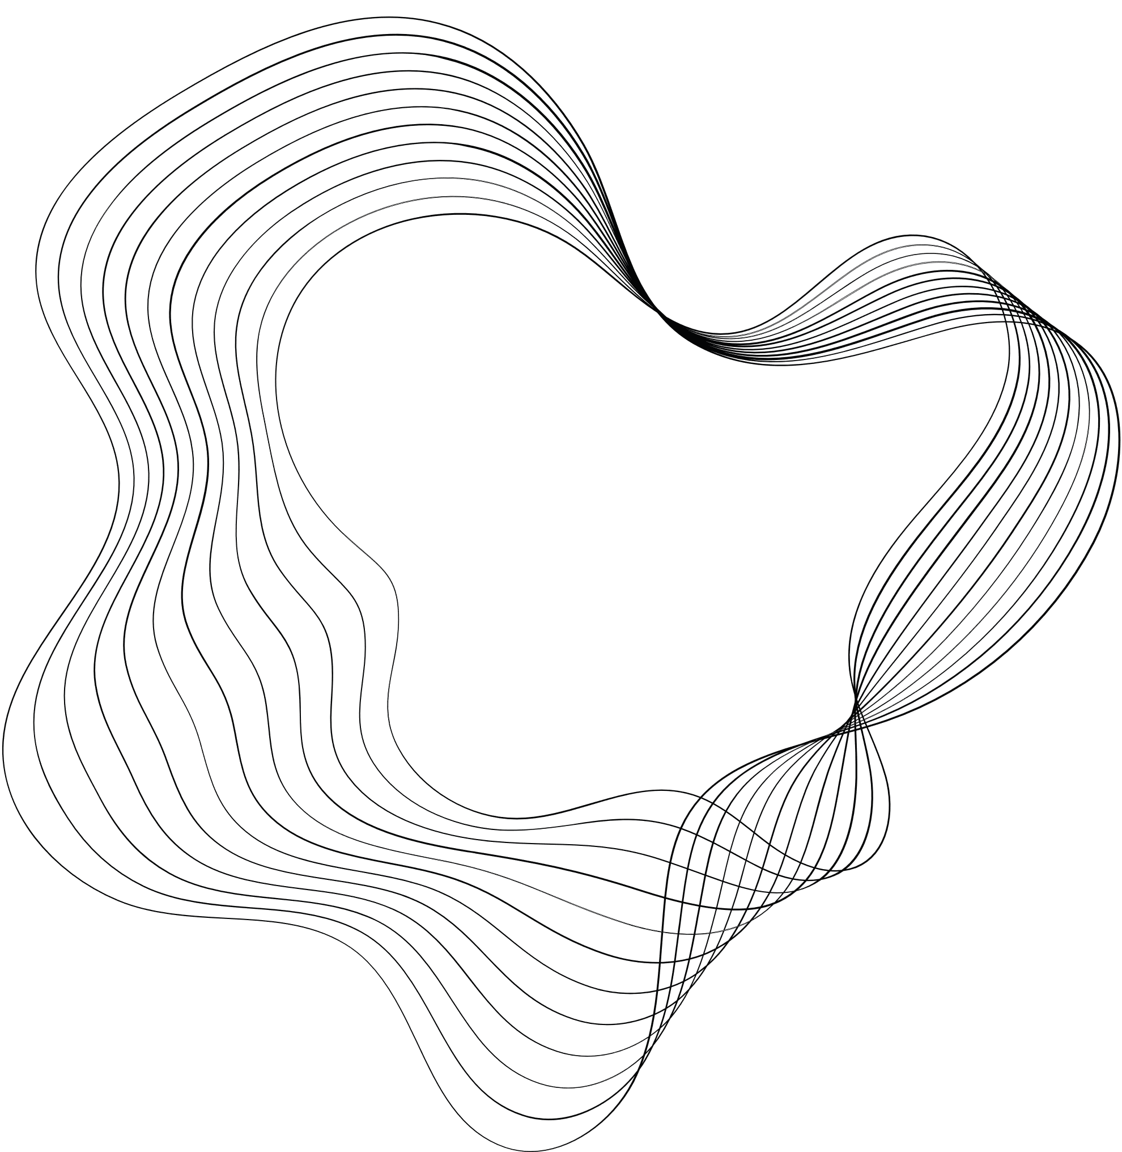

Topological Sorting {Decrease and Conquer}
Name : Hossam Abdelreheem Soltan
ID ; 224527

Slide 2
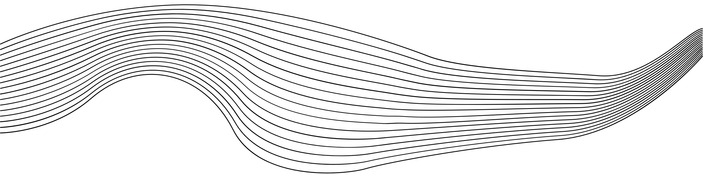
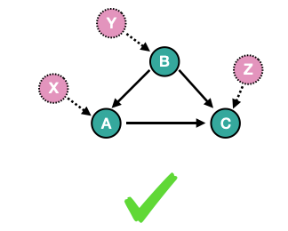
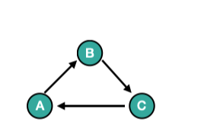
Topological sort :
Topological sort:
topological sort is a meaningful operation only for Directed Acyclic Graphs (DAGs)
DAG
Topological sorting is a linear arrangement of vertices in a directed acyclic graph (DAG). The order is for parents to come before children.
The topological sorting algorithms, such as Kahn's algorithm (based on BFS) or Depth-First Search (DFS)
Not a Dag

Slide 3
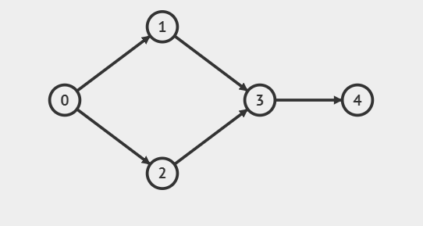
Example1:
Use topological sort by DFS- Depth first search (Dag).
Calculate in-degree of all nodes .
we will start any node with zero indegree or don’t have parent.

Slide 4
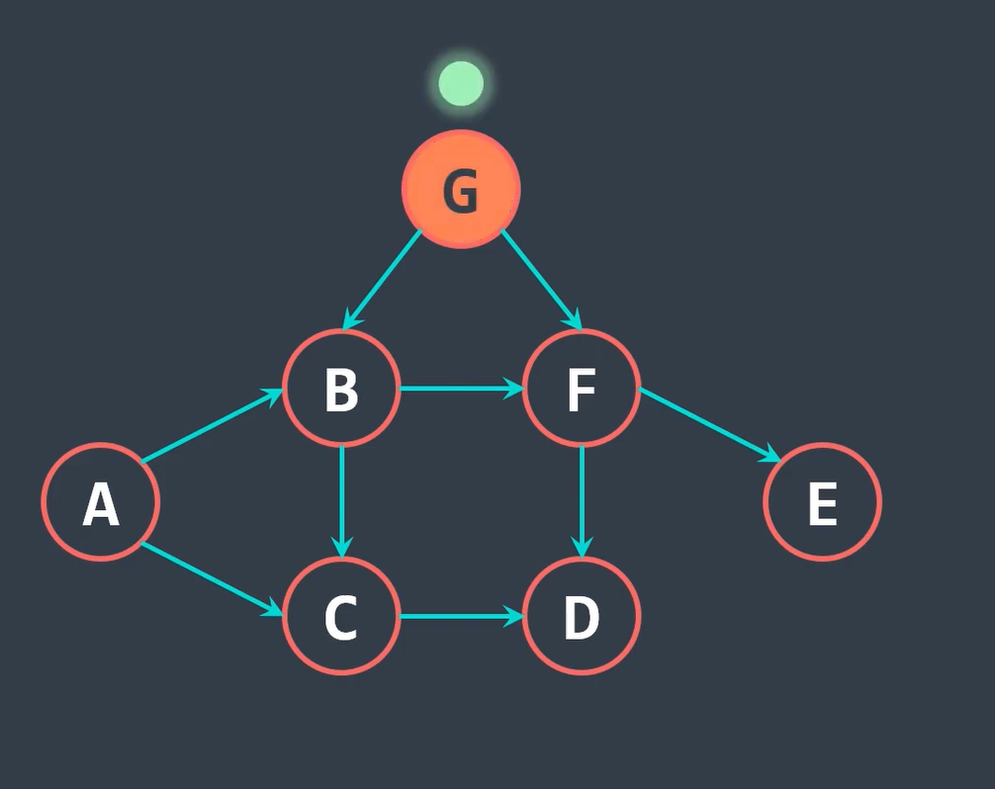
v
Illustration Topological Sorting Algorithm:
Step1:
We must start from nodes don’t have parent like (G,A).
Step 2:
Use strategy DFS .
Step 3:
Add to stack and so on.
Step 4:
When you back if the node don’t have neighbors Add to Stack and so on.
Step 5:
In the End, reverse the stack.

Slide 5
Topological Sort of the given graph 5 4 2 3 1 0
Cont.

Slide 6
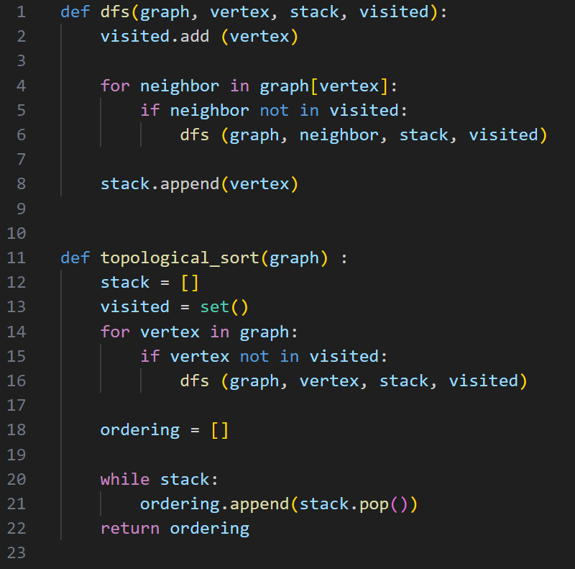
Code:

Slide 7


Analysis code:
Depth-first search: $\sum_{i=1}^{e}{1} =e−1+1=$O(E)
Popping all vertices from the stack: $\sum_{i=1}^{v}{1}=v−1+1=$O(V)
Topological sort : $\sum_{i=1}^{v}{1+O(E)}=v−1+1=$O(V + E)
T(n) = $∈$O(V + E)

Slide 8
Topological sort :
Topological sort:
Thank You

